Slide 1
Azure Automation
An Intro & Implementing dbatools
Shawn Melton
Notes:
I want to thank you all for picking this session.
My name is Shawn Melton and I’m going to cover Azure Automation and implementing dbatools.
Short note about myself:
I am a Microsoft MVP
Co-Maintainer and contributor of dbatools
Project Engineer @ Pythian for the last 4 years
On social media I’m wsmelton just about everywhere, so find me on Twitter or SQL Community Slack

Slide 2
Agenda
Intro to dbatools
Create an Azure Automation Account
Shared Resources
Cost/Security
Demos
Notes:
The agenda for day is to go over Azure Automation and some of the ins-and-outs.
Enough to get you started
While the focus is on one feature, just want to give you a few notes on the other features that are offered.
Once I get through the slides we will jump into demos and rest of the session is showing dbatools in Azure Automation
< pause >
Show of hands is anyone currently using dbatools in their environment?

Slide 3
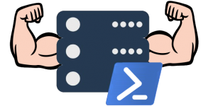
dbatools
An introduction
Notes:
dbatools (little dba) is:

Slide 4
dbatools
Online docs: https://docs.dbatools.io
GitHub: https://dbatools.io/dev
CI (Appveyor): https://dbatools.io/ci
Notes:
Open sourced PowerShell module
Written and developed by the SQL Server and PowerShell community
Allows you to administer SQL Server interactively or via automation
It has broken 150k downloads from the PowerShell Gallery
We have over 500 commands now that ranging from just getting a list of databases to building an AG across multiple servers
Online you can find our docs at docs.dbatools.io
Being open source we host it on GitHub, a short URL to find our repo is dbatools.io/dev
We handle running all of our pester test using Appveyor right now, and we made that all public
A little history if you didn’t know, the module came from a single script that Chrissy Lemaire published in 2014 for migrating SQL server.
I’ve been working with Chrissy on the module since later part of 2016.
The goal we’ve had is to make it where anything you needed to do with SQL Server could be done using PowerShell.
So, actions you may do over and over again in SSMS, we want to provide a way to do that in PowerShell.
Which once you can do it in PowerShell, allows you the opportunity to automation that action or process.
We have users that automate their backups or utilize it for applying best practices across multiple environments.
We have some that use it for reporting whether it be a team or management level.
What I want to show you is automation with the module for inventory or just gathering metrics of your server and databases.
You could do this with various tools but I want to focus on using Azure Automation.
< pause >
A show of hands is anyone already using Azure in some manner at their current company?

Slide 5
Azure Automation
A starting point
https://aka.ms/azureautomation
Notes:
All the documentation for Azure Automation can be found at: aka dot ms slash azure automation (one word)
Azure Automation is a service that falls under the “Management and Governance” category in Azure.
Other services are Azure Backup or Azure Monitor that fall under this category.
The Azure Automation was released in early 2014.
It was the first service in Azure that allowed you to manage your Azure resources but also integration with your on-premises resources.
It is globally available in the majority of regions for Azure.
I believe the new Africa region is not supported right now.
So, how do you get started with Azure Automation

Slide 6
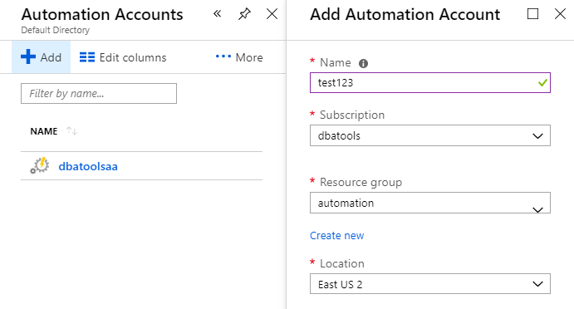
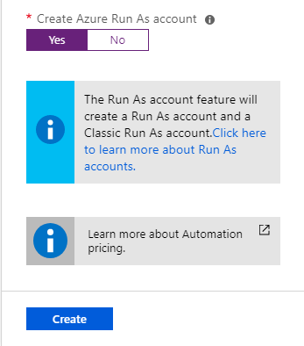
Azure Automation - Create
Create via Portal or Az module only
No Azure CLI support
Recommended to create with Azure Run As account
Notes:
You need to create an Azure Automation Account
Creating an account can be done via the portal or the Az.Automation PowerShell module.
Currently the Azure CLI does not support it.
You can also use ARM templates to deploy it as well.
When you create an account, you are simply asked for a few basic items:
Name (unique within the subscription)
Select the Subscription
Resource Group
Location/Region in Azure
Whether you want it to create the Run As account
I recommend always saying “YES” for the Run As.
They provide a link to learn more on the Run As account and what it is.
<slowly>
One note to make here is that the Run As is given contributor access to your subscription.
</slowly>
I’ve heard some do not let it create it simply because of that fact. It makes admins and security auditors nervous.
The Run As out of the box gives you full admin rights to everything under the subscription

Slide 7
Azure Automation - Capabilities
Process Automation (our focus)
Configuration Management
Update Management
Shared Resources
Notes:
After you create an account what do you get with it?
Process Automation:
Use runbooks that are an instance of a given script that you can schedule, trigger from another action, or manually run.
You can handle processing using two languages: PowerShell or Python 2
Python is pretty much just scripting in Python
PowerShell you have the option of doing a graphical setup, think of building a diagram in Visio.
You can build out task and your process flow in a graphical manner
You can utilize PowerShell Workflow as well in the graphical runbooks for async processing
You can utilize workflow in the basic PowerShell runbooks as well, you just have to code for it yourself
Configuration Management:
Inventory
Track state and changes for Azure VM or on-premises servers
State Configuration (Desired State Configuration/DSC)
Globally available pull server
Update Management:
Global WSUS service
Schedule updates
Alerting
Then we have the shared resources…

Slide 8
Shared Resources
Only those pertaining to Runbooks
Notes:
Shared Resources are just that, these are going to be assets that you can utilize and reference in Process Automation and Configuration Management.
I’m going to do a quick run through of each one that we will utilize but you will see more of this in the demo later.
I’ll note that within a runbook you call out to the Automation service to interact with each resource. I’ve included that command for each one as the last bullet point on each slide.

Slide 9
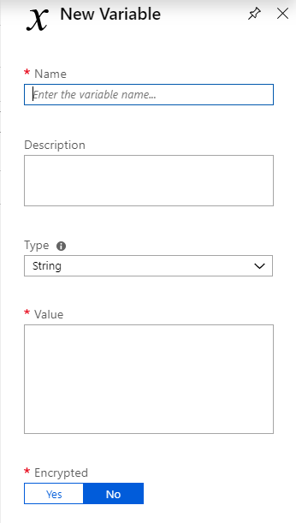
Shared Resources (Variables)
Persisted values
Set within a runbook
Common Types
Complex objects (PSCustomObject)
Encrypted values
Get-AutomationVariable
Set-AutomationVariable
Notes:
Variables, in a PowerShell script is an object that contains a single value or complex object (array, list, etc.).
You can generally take that value and manipulate it or use it in another action.
It is the same concept in Automation accounts, with one exception.
In PowerShell that variable’s lifespan exists for the life of your session, Automation you can persist that value.
You populate the variable from the portal at any time or you can populate it from a runbook.
You use the Get and Set command noted on the slide.
There is also an equivalent command in the Az module, but a main difference is on encrypted or sensitive variables you cannot read that value in plain text from the Az module.
It does not have the decrypt ability.

Slide 10
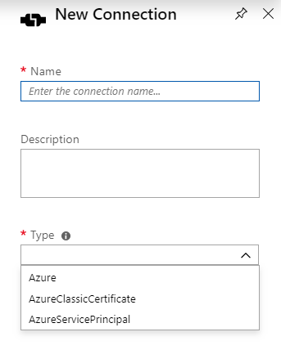
Shared Resources (Connections)
RunAs Accounts
Three types
AzureServicePrincipal interact with another Azure service
Get-AutomationConnection
Notes:
Connections are the Run As credentials that are created when you create an Azure Automation accounts
The other type is the Azure Service Principal, which allows you to say make a connection to interact with another service and authenticate using Azure Active Directory (or your on-premises AD if that is configured properly).

Slide 11
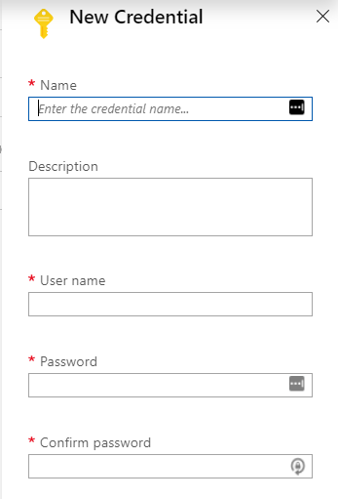
Shared Resources (Credentials)
Store username/password combinations
Reference in runbook
Treated as PSCredential Object
Get-AutomationPSCredential
Notes:
Credentials are just that, a username and password pair.
The get command will return a PSCredential object for you, so does not require any fancy code to build it.
In our case with dbatools we accept PSCredential objects for authentication so you can just run the Get to a variable and pass that into a dbatools command.
Same rule applies as the variables, there is a Az module command but it will not decrypt the password value.
Within an Azure Automation Account, you have some shared resources that the various features utilize.

Slide 12
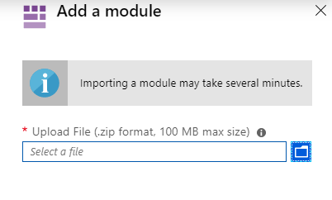
Shared Resources (modules)
Import manually (zip)
Import via Gallery
Does not allow side-by-side
100MB max archive size
New-AzAutomationModule
Notes:
Modules are any module you can find from PowerShell Gallery; you can utilize in a PowerShell runbook.
Custom modules simply must be a zip file that is structured as a formal PowerShell module, with a manifest file at a minimum.
When you are uploading there is a hard limit of 100MB size for that zip file.
A pain point for me on this resource is limitations on upgrade and side-by-side support.
On your machine you can have 5 different versions of xzy module installed.
In Automation account when you update the module it will overwrite/remove the previous version…only allowed one version to exist.
Just something to deal with and I’m not aware of any roadmap right now for that to change.

Slide 13
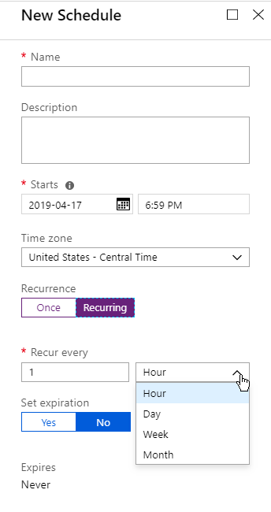
Shared Resources (schedules)
Schedule start time only
Allows selection of TZ
Run once
Run recurring
Set expiration
Notes:
Scheduling runbooks you have the option for setting the start time only.
It does allow you to control the time zone for each schedule if needed.
You can get very granular on recurring schedules but lowest frequency you can do is an hour.
If you need finer control it requires multiple schedules and staggering them to your need.
Now the last bit before we get into runbooks is on cost and security

Slide 14
Cost and Security
How much?
How safe?
Notes:
The update management is free, does not cost you a dime, and can be used for Azure VM or your on-premises environment.

Slide 15
Azure Automation (cost)
Configuration Management
* Price pro-rated hourly
LCM defaults to 15 minute check-in
LCM = Local Configuration Manager
Item | Price
Azure VMs | $0.00
Non-Azure (1st 5 nodes) | $0.00
Non-Azure (after 5) | $6/node*
Notes:
Configuration Management remember I mentioned this is a pull server setup.
Your target node talks out to this service.
If the node is an Azure VM, you are not charged anything.
Your on-premises servers are charged after the first 5, so that 6+ servers will cost you.
The LCM in DSC is what talks out to the pull server in Azure.
By default that LCM on each server will call out every 15 minutes, this is something you can modify if you want.
That 6th server you add, talks every 15 minutes will cost $6 USD a month.
Now, Process Automation cost have the most detail compared to the other ones

Slide 16
Azure Automation (cost)
Process Automation
Item | Price
Jobs (1st 500 minutes) | $0.00
Jobs (501+ minutes) | $0.002/minute
Watchers (1st 744 hours) | $0.00
Watchers (744+ hours) | $0.002/hour
Notes:
The cost comes from the scheduling side and running jobs manually.
Of all the jobs you schedule or run you are giving 500 minutes, first 8 hours for free.
After that is two hundredths of a cent per minute.
Watchers are just runbooks that you use for well watching for events or an action.
You have a runbook that watches a given process or for something to “be” and then you have an action runbook that does something.
You are given 31 days of watchers for free, and then after is two hundredths of a cent per hour.

Slide 17
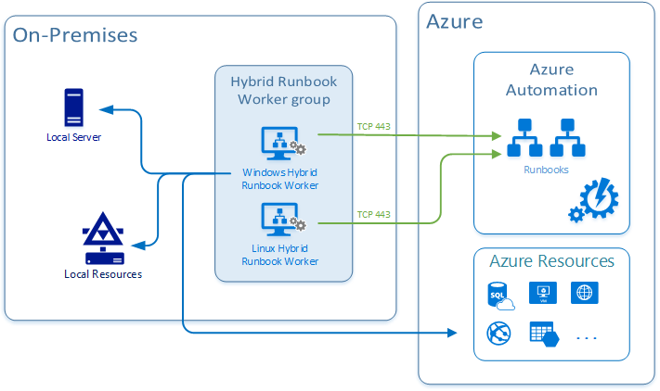
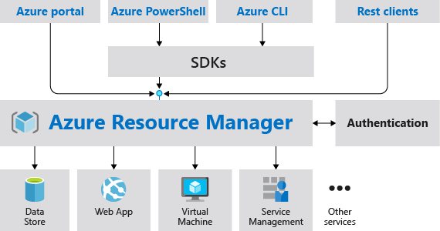
Azure Automation - Security
References:
https://docs.microsoft.com/en-us/azure/automation/automation-hybrid-runbook-worker
https://docs.microsoft.com/en-us/azure/azure-resource-manager/resource-group-overview
https://blogs.msdn.microsoft.com/brunoterkaly/2012/02/07/azure-ports/
Notes:
The security side of Azure Automation.
Everything between Azure resources is in-network.
When you go hybrid, all of the features talk over TCP port 443.
If you have a runbook (like we will in demo) that talks to Azure from a hybrid setup, that is going over the protocol and port for that service.
So, I’ll show you example code that I write data back to an Azure SQL DB, if I was running that from an on-premises or environment outside of Azure it will communicate over TCP 1433 (protocol for Azure SQL).
I must ensure the normal firewall rules and access configuration is in place for Azure SQL from the server that runs my runbook.

Slide 18

Notes:
DEMO TIME!!!

